Slide 1

Evaluating the use of AI as an adaptive user experience for mental health support
Presented by Connor Murphy

Slide 2
Aim: evaluate the real-world practicality of an AI based adaptive user interface
Identify/Evaluate user emotional state recognition methods.
Develop an accurate AI using the identified method
Develop An adaptive User Interface application
Preform a user experiment using the adaptive user Interface
Analise the results for significant results

Slide 3
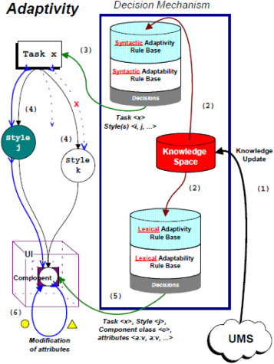
Background: Adaptive User Interfaces
Wide area of research. Specifically focusing on adaptivity.
Examples include active screen resizing, customisable dashboards, GPS changing directions on a wrong turn.
Proposed AI methodology learns from data scraped from the internet
A current problem in the field is the lack of agreed upon methodology

Slide 4
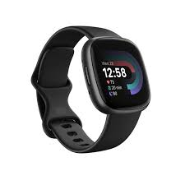
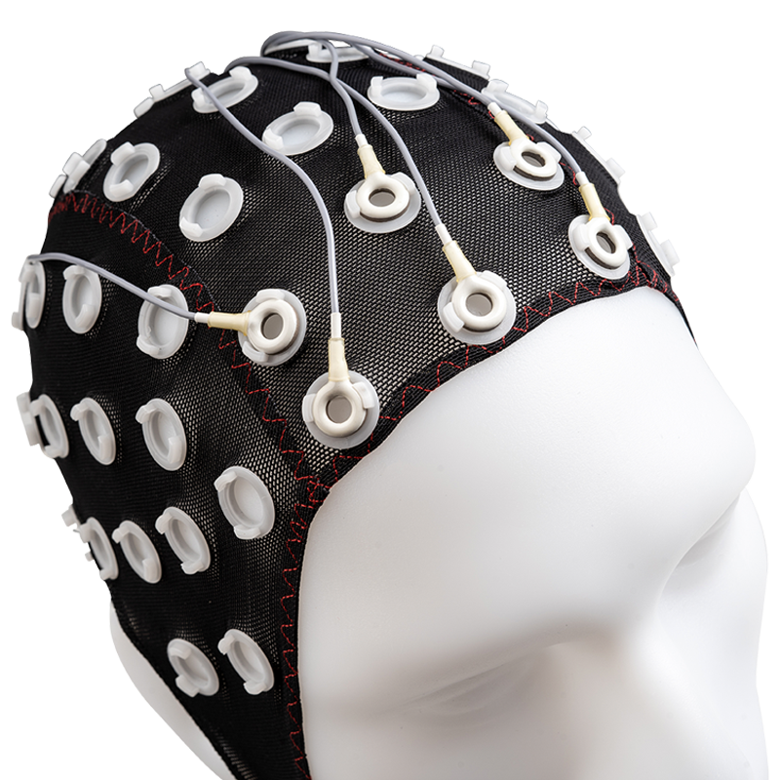
Background: Emotion recognition methods
Electrocardiography, Galvanic skin response, Eye movement, Variability in heart rate, repository rate
Too invasive for everyday use

Slide 5
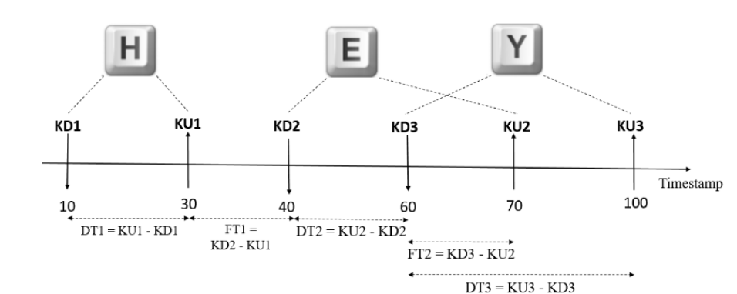
Background: keyboard Dynamics
Characterised by the timing of key presses. Has seen success in both desktop and mobile applications

Slide 6

Proposed method 1
Utilise colour theory to influence the user towards a positive mental space
Change the background and accents based on the AI estimation.
Compare adaptive vs a nonchanging version of the same application.
Artifacts
Trained AI, Adaptive/nonadaptive application

Slide 7

Proposed method 2
Utilise positive messaging and emotional grounding techniques to influence the user towards a positive mental space.
An individualised AI should have a higher accuracy than a generalised AI leading to a better experience.
Compare generalised vs an individualised version of the same application.
Artifacts
Website, Trained AI, Adaptive/nonadaptive application.

Slide 8
Expected out comes
Method 1
The User Experience analysis will show a significant difference between the adaptive and nonadaptive application. Favouring the adaptive application
Method 2
There should be a higher accuracy rate for the AI tailored to the individual.
The User Experience analysis will show a significant difference between the individual and the generalised application. Favouring the adaptive application

Slide 9
References
Miraz, M.H., Ali, M. and Excell, P.S., 2021. Adaptive user interfaces and universal usability through plasticity of user interface design. Computer Science Review, 40, p.100363. Available at: https://doi.org/10.1016/j.cosrev.2021.100363
Dzedzickis, A., Kaklauskas, A. and Bucinskas, V., 2020. Human emotion recognition: Review of sensors and methods. Sensors, 20(3), p.592. Available at: https://doi.org/10.3390/s20030592
Yang, L. and Qin, S.F., 2021. A review of emotion recognition methods from keystroke, mouse, and touchscreen dynamics. Ieee Access, 9, pp.162197-162213.
Aicha Maalej, Ilhem Kallel, 2020. EmoSurv: A typing biometric (Keystroke dynamics) dataset with emotion labels created using computer keyboards. Available at: https://dx.doi.org/10.21227/eae6-pk42.
Hulshof, B., 2013. The influence of colour and scent on people’s mood and cognitive performance in meeting rooms (Master's thesis, University of Twente). Available at: https://essay.utwente.nl/63446/

